Slide 1
Drought Legacies and Implications for Soil Microbiome Resilience
Bin Wang
Ecology and Evolutionary Biology
University of California Irvine

Slide 2
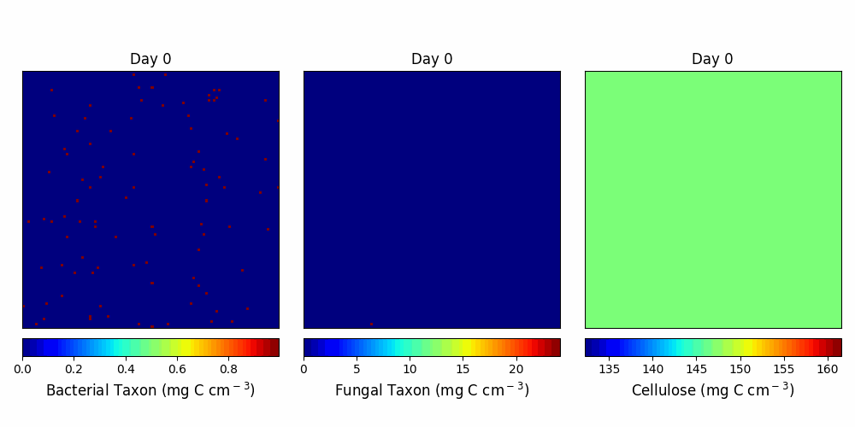

Slide 3
A
B
default
C
D
dispersal
E

Slide 4
Year-6
Year-9
A
B
default
C
D
dispersal

Slide 5
A
B
default
C
D
dispersal

Slide 6
A
Year-6
B
Year-9
default
C
D
dispersal

Slide 7
A
default
B
C
dispersal
D

Slide 8
A
Year-6
B
Year-9
default
C
D
dispersal

Slide 9
A
default
C
dispersal
B
D

Slide 11
A
B
C
D

Slide 12
Drought legacy-driven microbiome trajectories on the 2-D space
No legacy
?
Enzyme Investment
Transient legacy
Persistent legacy
Drought tolerance

Slide 13
S
?
Persistent legacy
Transient legacy
No legacy
Y
A

Slide 14
S
Persistent legacy
?
Transient legacy
No legacy
Microbial community before ( ) and after ( ) drought disturbance
Y
A

Slide 15
S
Y
A

Slide 16
Version 1

Slide 17
Community Dynamics

Slide 18
Community-level Drought Tolerance and Enzyme Investment

Slide 19
Tradeoff between Enzyme Investment and Yield
Year 6
Year 9

Slide 20
Dispersal

Slide 21
Tradeoff between Enzyme Investment and Yield
Year 6
Year 9

Slide 22
Drought legacy in litter decomposition

